Slide 1
Combining views from multiple cameras

Slide 2
Over the past decade or so there has been a surge of interest in multi-camera surveillance systems.
Multiple cameras are clearly necessary if, e.g. long stretches of motorway are to be monitored, or if pedestrians are to be tracked around cities or shopping precincts.
The field of view (FOV) of a single camera is quite restricted and the resolution available for viewing in the distance will almost certainly be inadequate for detailed observation.
Another reason for the use of several cameras is that of viewing in stereo and obtaining sufficient depth information.

Slide 3
A further reason is that pedestrians in a precinct will frequently be partially or wholly occluded by architectural features such as statues or other pedestrians, but the chance of missing a pedestrian will be much less if the scene is viewed by multiple cameras; this sort of situation will also apply on roads, where many other possibilities for occlusion exist.
On roads, cameras are often mounted on overhead gantries, and maintaining observation over long distances will require many cameras.
This raises the question of whether the observation should be unbroken, i.e. whether the cameras will have overlapping, contiguous, or nonoverlapping views.

Slide 4
On motorways, cameras may be separated by several miles, and can usefully be sited at junctions, so it will be possible to keep track of all vehicles without too much expense, though breakdowns at intermediate locations may not be observed.
On the other hand, in a shopping precinct, if pedestrians are to be monitored closely enough for attacks or terrorist activities to be detected, contiguous, or overlapping views will be mandatory.
In fact, there will be a problem in ensuring that all pedestrians are positively identified as they progress from one FOV to the next: to facilitate this, and for ease of setting up the system, overlapping views are normally required.

Slide 5
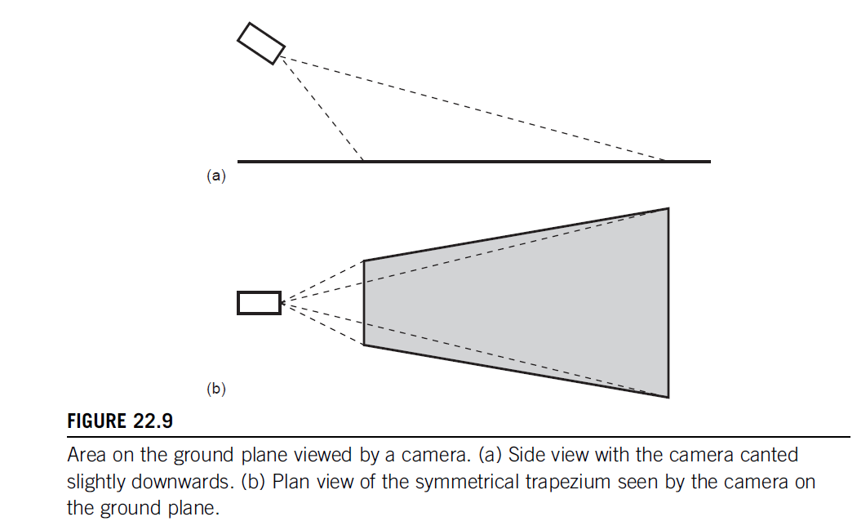

Slide 6
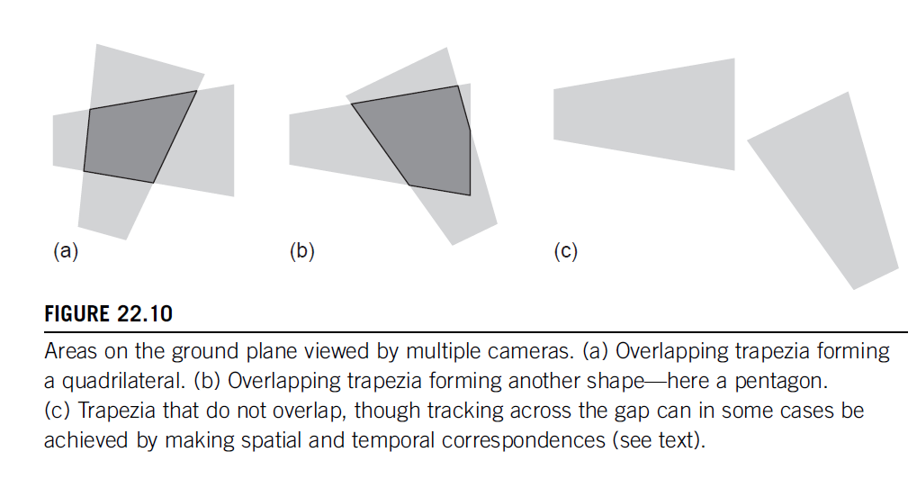

Slide 7
Next we consider the layout of a multi-camera system.
To do this we must examine the area of the ground plane that lies within the FOV of the camera.
First, note that the optical axis of the camera passes through the center of the image plane and that the latter has a rectangular shape given by the minimum and maximum values of x and y, 6xm and 6ym. The FOV is therefore limited by four planes, at horizontal and vertical angles 6α and 6β, where tan α5xm/f and tan β 5ym/f, f being the focal length of the camera lens.

Slide 8
Each plane will intersect with the ground plane in a line, and for a camera with a horizontal x-axis, the viewed area on the ground plane will be a symmetrical trapezium
However, following on from the discussion in if the camera is not inclined slightly downward, the distant side of the trapezium will not be visible.
Since this would not make the most of the camera FOV, we will
assume that it has been arranged for the distant side to fall on the ground plane.

Slide 9
No matter which of the reasons for using a multi-camera system apply, there is a need to relate the views from the separate cameras in order to obtain a consistent labeling of the objects passing between them.
The obvious means of achieving this is by appearance, i.e. to apply recognition algorithms to establish that the same person or vehicle is being tracked across the various camera fields of view.
Unfortunately, while this correspondence problem can normally be solved straightforwardly in binocular vision, when the two cameras are close together and pointing in a similar direction, this is by no means true for wide baseline cases such as those shown in Fig.

Slide 10
This is so for two reasons:
(1) a person seen in two disparate views may have an altogether different appearance, e.g. the face may be visible in one and the back of the head in the other; or the back of a shirt may have a different design or color from the front;
(2) the illumination may be quite different for each of the viewsand this will make it even more difficult to confirm the person’s identity from the other camera.

Slide 11
The Case of Nonoverlapping Fields of View
Next we move on to the case of nonoverlapping fields of view.
Here there seems to be no basis for homographies or for reliable camera handoff.
However, some degree of similarity in appearance will still be detectable between views in addition, there will be strong correlations between the time of leaving one FOV and arriving in another.
The situation will often be helped if there is some restriction of access, such as would occur if there is a single adjoining door. (On a motorway, there is anyway such a restriction, and temporal correlations can be strong.)

Slide 12
how to relate the camera calibration matrices when overlapping views are not available. While this seems intrinsically impossible because no common image points can be found and hence no equations can be obtained linking the parameters
They have found that if velocities are assumed to be more or less constant across the intervening space, this provides the continuity needed to permit enough equations to be found.

Slide 13
